Slide 1
React Components

Slide 2
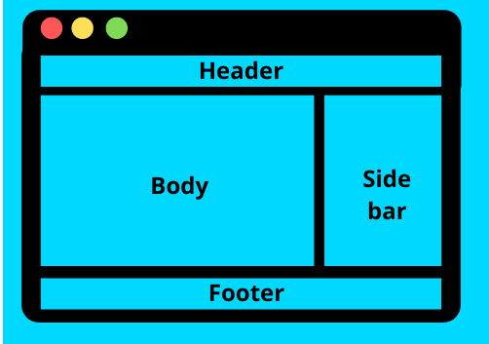
React Components
Every application you will develop in React will be made up of pieces called components.
Components make the task of building UIs easier.
Component has its own logic and appearance.
UI is broken down into multiple individual pieces called components and we can work on them independently and merge them all in a parent component which will be final UI.
A component can be as small as a button, or as large as an entire page.

Slide 3
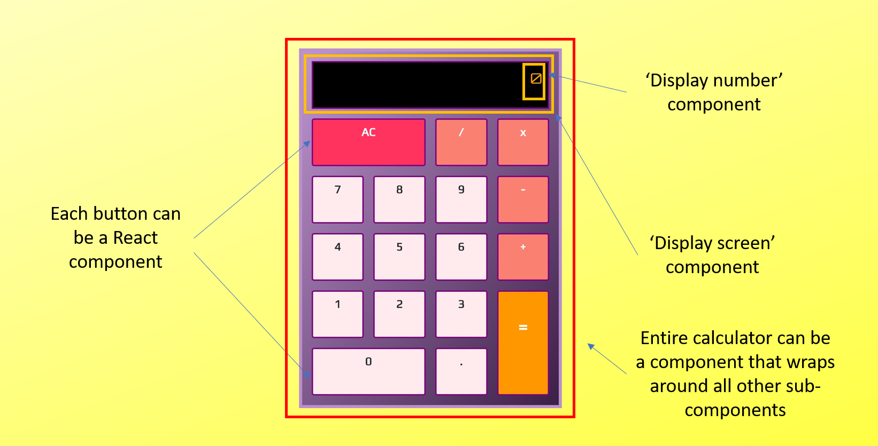
React Components

Slide 4
React Components
React component names must always start with a capital letter, while HTML tags must be lowercase.
React components are JavaScript functions that return markup
The markup syntax is called JSX. It is optional, but most React projects use JSX for its convenience.
Quick Start – React

Slide 5
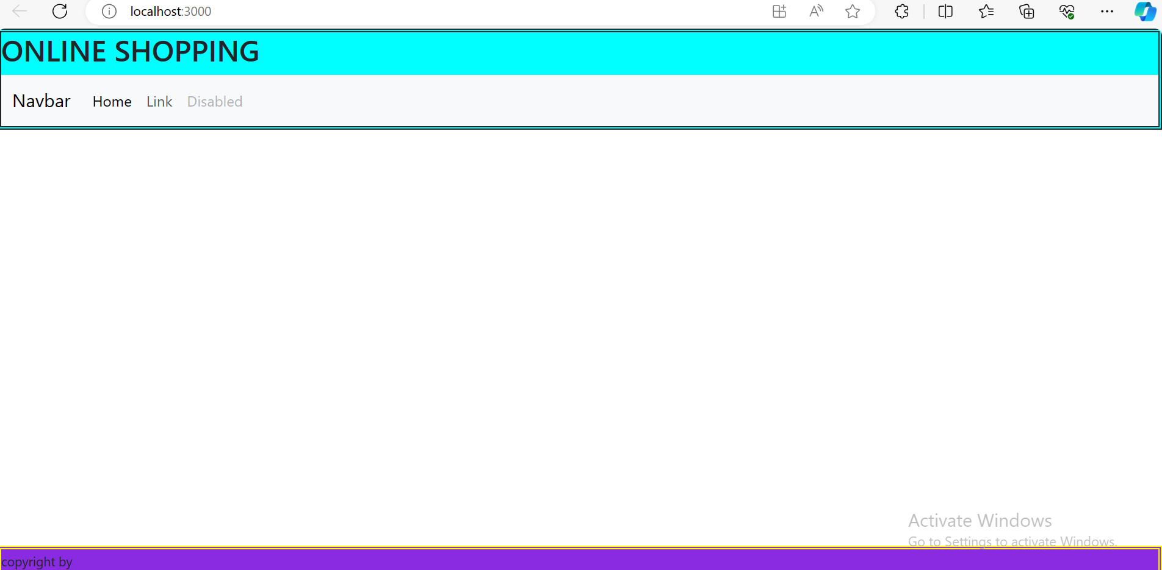
Example
App
Header Footer
Navbar

Slide 6
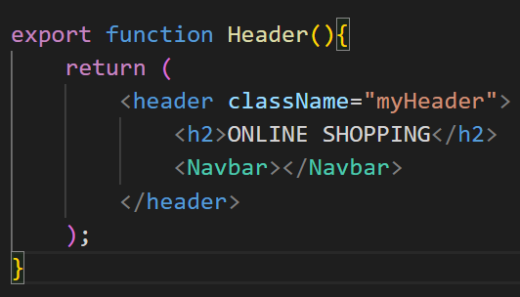
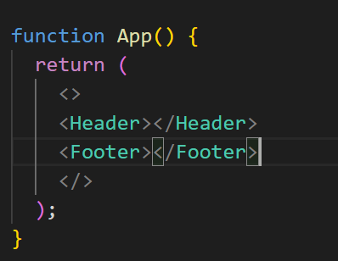
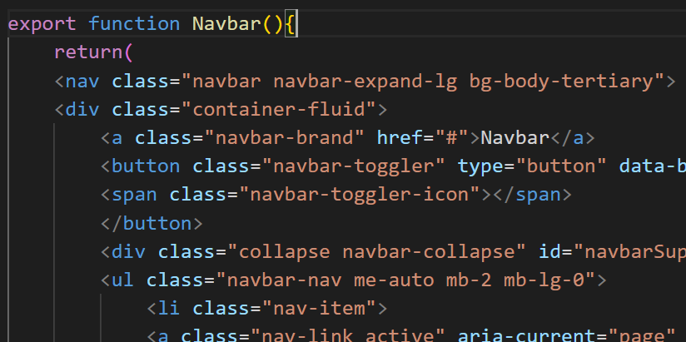
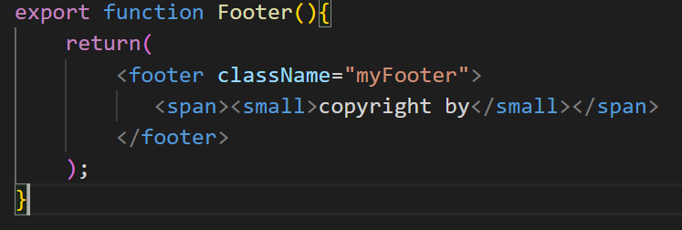
App, Header, Footer, Navbar

Slide 7
Adding Bootstrap to React
Using the Bootstrap CDN
Importing Bootstrap in React as a dependency
npm install bootstrap
// Bootstrap CSS
import "bootstrap/dist/css/bootstrap.min.css";
// Bootstrap Bundle JS
import "bootstrap/dist/js/bootstrap.bundle.min";
Installing a React Bootstrap package such as React-Bootstrap or Reactstrap

Slide 8
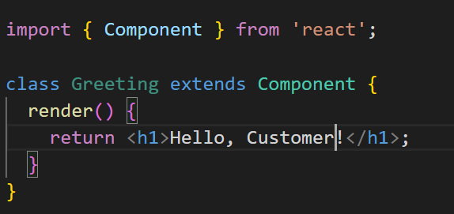
Class Components

